Slide 1
Regression Diagnostics
Vishnuprasad Nagadevara
Nagadevara_v@isb.edu

Slide 2
Preliminary Diagnostics
Coefficient of determination R²
Adjusted R²
ANOVA and F test
t-Tests for individual significance

Slide 3
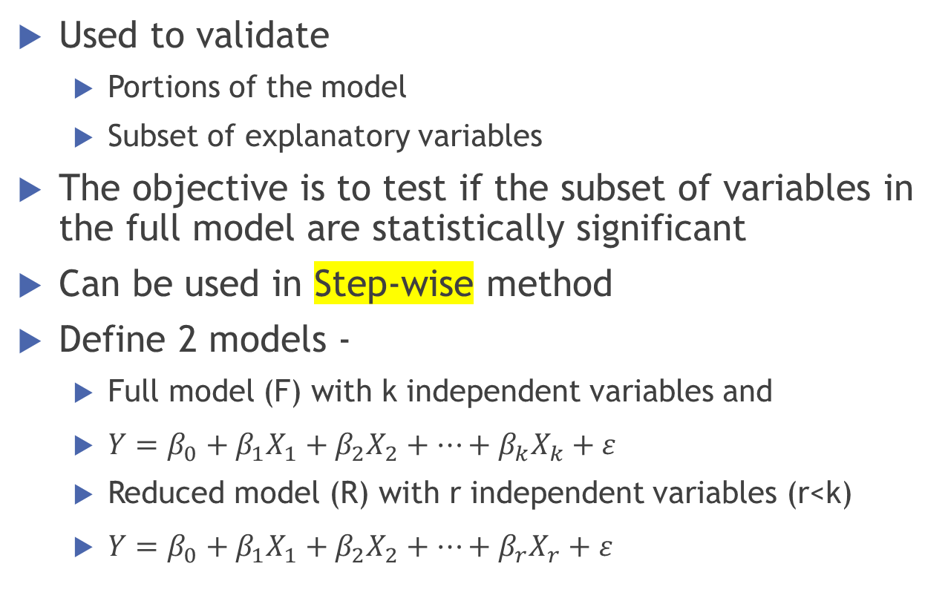
Partial F Test
Used to validate
  Portions of the model
  Subset of explanatory variables
The objective is to test if the subset of variables in the full model are statistically significant
Can be used in Step-wise method
Define 2 models -
  Full model (F) with k independent variables and
  $Y=β_{0}+β_{1}X_{1}+β_{2}X_{2}+…+β_{k}X_{k}+ε$
  Reduced model (R) with r independent variables (r<k)
  $Y=β_{0}+β_{1}X_{1}+β_{2}X_{2}+…+β_{r}X_{r}+ε$

Slide 4
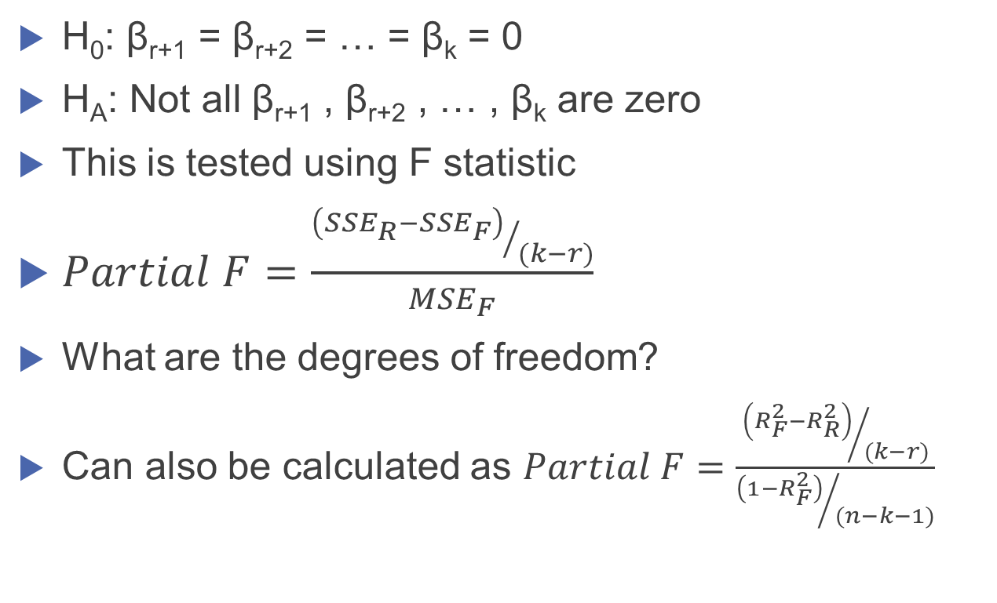
Hypothesis Test
H₀: β_{r+1} = β_{r+2} = … = β_{k} = 0
H_{A}: Not all β_{r+1} , β_{r+2} , … , β_{k} are zero
This is tested using F statistic
$Partial F=\frac{{\left({SSE}_{R}−{SSE}_{F}\right)}/{(k−r)}}{{MSE}_{F}}$
What are the degrees of freedom?
Can also be calculated as $Partial F=\frac{{\left(R_{F}^{2}−R_{R}^{2}\right)}/{(k−r)}}{{\left(1−R_{F}^{2}\right)}/{(n−k−1)}}$

Slide 5
Revisit - Gender Divide
Reduced Model
Full Model
(Constant)
Commerce
Technology
Science
PostGrad
Analytics
Experience in the Company
Gender
Gender_Exper
Prior Exp
(Constant)
Commerce
Technology
Science
PostGrad
Analytics
Experience in the Company
Gender
Gender_Exper
Prior Exp
Org Level B
Org Level C
Org Level D
Org Level E
Org Level F

Slide 6
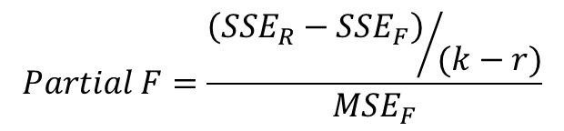
Revisit - Gender Divide
Model | Source | Sum of Squares | df | Mean Square | F | Sig.
Full | Regression | 3,027,080,069,494 | 14 | 216,220,004,963 | 61.800 | .000
 | Residual | 647,262,158,474 | 185 | 3,498,714,370
 | Total | 3,674,342,227,968 | 199
Model | Source | Sum of Squares | df | Mean Square | F | Sig.
Reduced | Regression | 2,669,313,811,490 | 9 | 296,590,423,498 | 56.070 | .000
 | Residual | 1,005,028,416,478 | 190 | 5,289,623,245
 | Total | 3,674,342,227,968 | 199
$$Partial F=\frac{{\left({SSE}_{R}−{SSE}_{F}\right)}/{(k−r)}}{{MSE}_{F}}$$
$$Partial F=20.4513 and p−Value=3.1435X{10}^{−16}$$

Slide 7
The Coefficients
 | Unstandardized Coefficients |  | t | Sig.
 | B | Std. Error
(Constant) | 375522.8 | 14725.0 | 25.502 | .000
Commerce | -48444.3 | 15594.1 | -3.107 | .002
Technology | -27533.0 | 12152.9 | -2.266 | .025
Science | -12635.7 | 26826.6 | -.471 | .638
PostGrad | 67072.5 | 11805.3 | 5.682 | .000
Analytics | 48826.0 | 19713.2 | 2.477 | .014
Experience in the Company | 16716.7 | 1000.8 | 16.704 | .000
Gender | 31300.2 | 17495.3 | 1.789 | .075
Gender_Exper | -13081.7 | 1514.9 | -8.635 | .000
Prior Exp | 1258.3 | 1774.6 | .709 | .479

Slide 8
Autocorrelation

Slide 9
Autocorrelation
Autocorrelation is defined as correlation between members of series of observations ordered in time.
In regression, it is assumed that the successive error terms (residuals) are independent.
If there is dependence between successive error terms, then
  Cov(e_{i} , e_{j}) ≠ 0

Slide 10
Durbin Watson Test
Durbin Watson test checks the presence of first order autocorrelation.
Durbin Watson test is:
  H₀ : ρ₁ = 0
  H₀ : ρ₁ ≠ 0
ρ₁ is the correlation between error terms of lag 1

Slide 11
Durbin Watson Statistic
There is no unique critical value of d that will lead to the rejection or acceptance of the null hypothesis

Slide 12
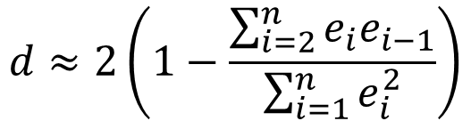
Durbin Watson Statistic
Alternatively
$$d≈2\left(1−\frac{\sum_{i=2}^{n}{e_{i}e_{i−1}}}{\sum_{i=1}^{n}{e_{i}^{2}}}\right)$$
It can be shown that d value lies between 0 and 4

Slide 13
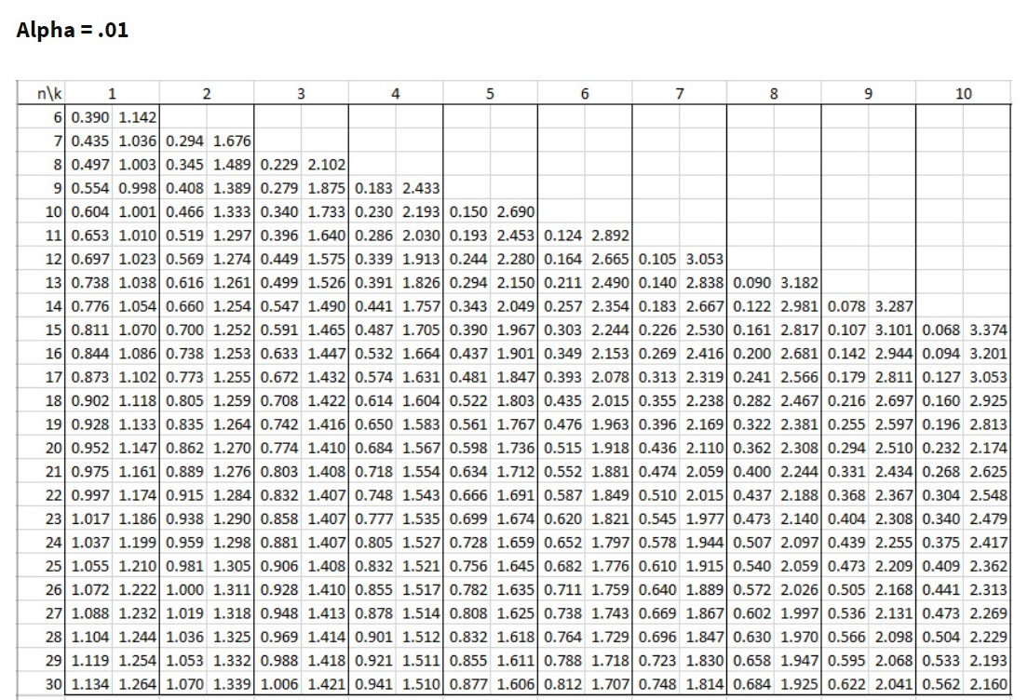
Durbin Watson Critical Values (α=0.01)

Slide 14
Critical Regions of Durbin Watson test
0
d_{L}
d_{U}
4 -d_{U}
4 -d_{L}
4
Positive autocorrelation
No autocorrelation
Negative autocorrelation
Inconclusive
Inconclusive

Slide 15
United Technologies
Model Summary^{b}
R | R Square | Adjusted R Square | Std. Error of the Estimate | Durbin-Watson
.998ª | .997 | .996 | 1395.6099 | 1.520
a. Predictors: (Constant), T2, OTINC, MATERIAL
b. Dependent Variable: SALES
Coefficientsª
 | Un-standardized Coefficients |  | Standardized Coefficients | t | Sig.
 | B | Std. Error | Beta
(Constant) | 733.934 | 495.701 |  | 1.481 | .158
MATERIAL | 1.292 | .081 | .676 | 15.917 | .000
OTINC | 3.195 | .468 | .163 | 6.832 | .000
T2 | 35.339 | 7.663 | .194 | 4.611 | .000

Slide 16
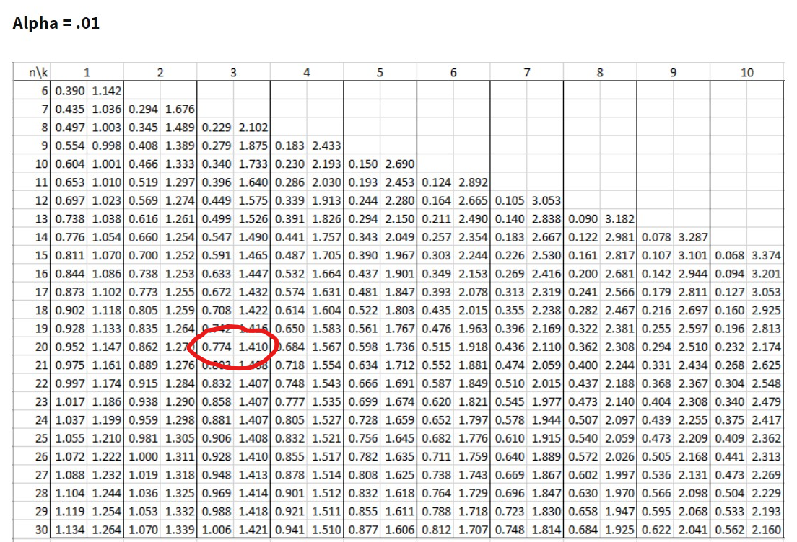
Critical Regions of Durbin Watson test United Technologies
n=20; k= 3
D=1.520
0
d_{L}
d_{U}
4 -d_{U}
4 -d_{L}
4
0.774
1.410
2.590
3.226
Positive autocorrelation
No autocorrelation
Negative autocorrelation
Inconclusive
Inconclusive

Slide 17
Multiple Regression
AIC
BIC

Slide 18
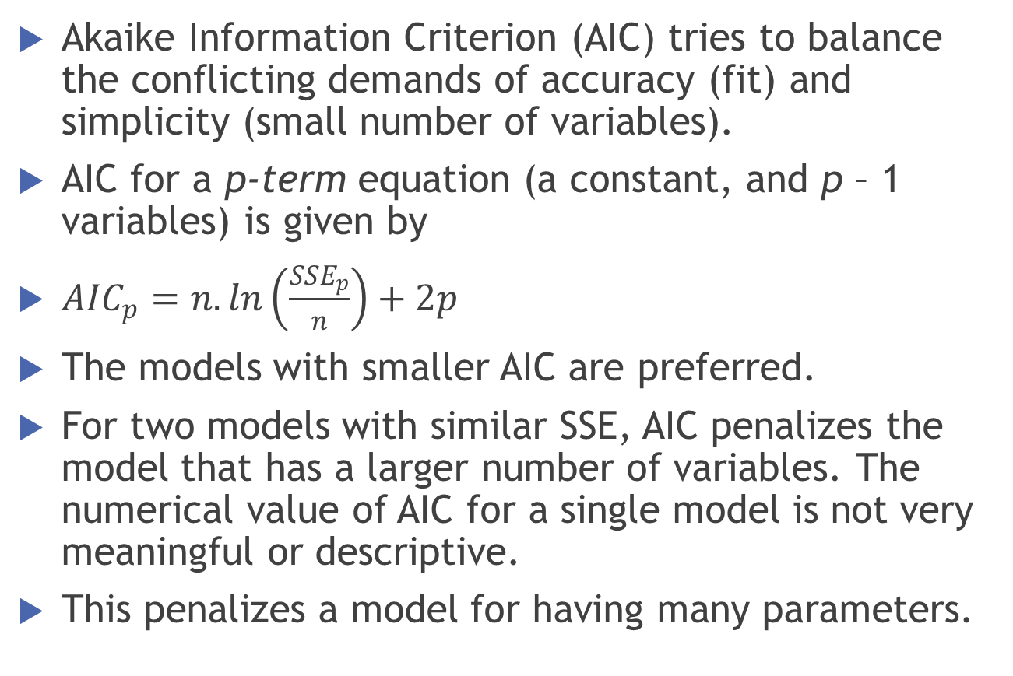
AIC
Akaike Information Criterion (AIC) tries to balance the conflicting demands of accuracy (fit) and simplicity (small number of variables).
AIC for a p-term equation (a constant, and p – 1 variables) is given by
${AIC}_{p}=n.ln\left(\frac{{SSE}_{p}}{n}\right)+2p$
The models with smaller AIC are preferred.
For two models with similar SSE, AIC penalizes the model that has a larger number of variables. The numerical value of AIC for a single model is not very meaningful or descriptive.
This penalizes a model for having many parameters.

Slide 19
AIC - Advantages
Used to rank the models on the basis of their twin criteria of fit and simplicity.
Models with AIC not differing by 2 should be treated as equally adequate.
Larger differences indicate significant difference in quality of the models.
It allows us to compare non-nested models
Even though a simple model is farther from the true model than is a more complex model, it may be preferred because it tends to provide better estimates of certain characteristics of the true model
The optimal model is the one that tends to have fit closest to reality.

Slide 20
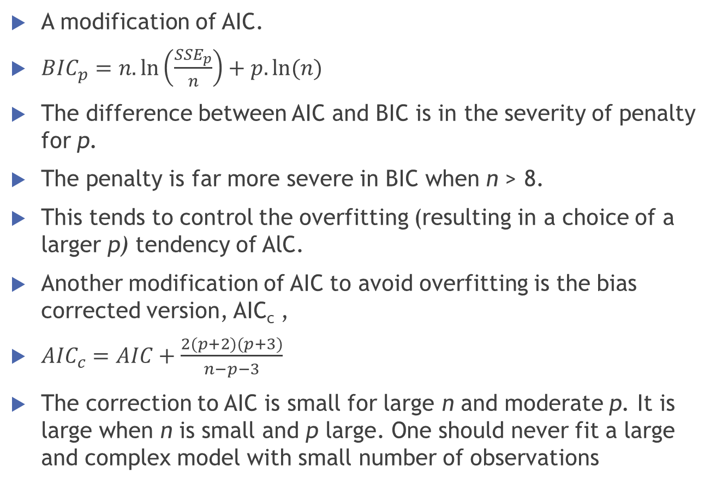
BIC (Bayes Information Criterion)
A modification of AIC.
${BIC}_{p}=n.\ln\left(\frac{{SSE}_{p}}{n}\right)+p.ln⁡(n)$
The difference between AIC and BIC is in the severity of penalty for p.
The penalty is far more severe in BIC when n > 8.
This tends to control the overfitting (resulting in a choice of a larger p) tendency of AlC.
Another modification of AIC to avoid overfitting is the bias corrected version, AIC_{c} ,
${AIC}_{c}=AIC+\frac{2(p+2)(p+3)}{n−p−3}$
The correction to AIC is small for large n and moderate p. It is large when n is small and p large. One should never fit a large and complex model with small number of observations
Notes:
originally proposed by Schwarz (1978),
AICcproposed by Hurvich and Tsai (1989), which is given by

Slide 21


Visual Interpretation of $\hat{Y} and μ_{\hat{Y}}$
$$\hat{Y}$$
X₀

Slide 22
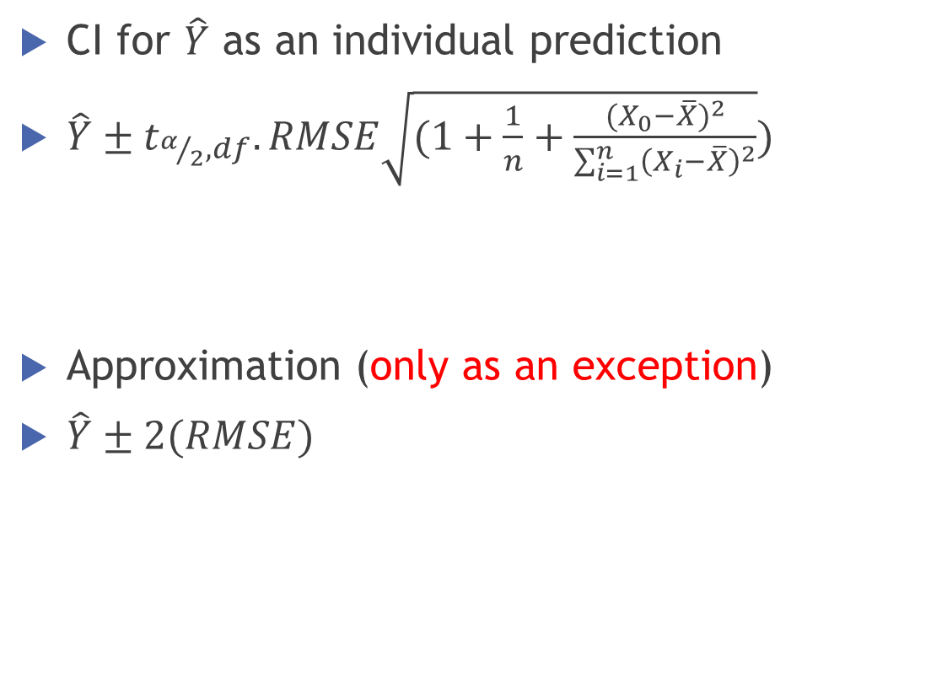
Confidence Intervals
CI for $\hat{Y}$ as an individual prediction
$\hat{Y}±t_{α/2,df}.RMSE\sqrt{(1+\frac{1}{n}+\frac{{(X_{0}−\overline{X})}^{2}}{\sum_{i=1}^{n}{{\left(X_{i}−\overline{X}\right)}^{2}}}})$
Approximation (only as an exception)
$\hat{Y}±2(RMSE)$

Slide 23

Confidence Intervals
Confidence intervals are narrower near the mean of the predictor and when the sample size is very large the sampling variation in b₀ and b₁ are expected to be low
However, no matter how large the sample size is, there is always an error in prediction intervals
Upper Confidence Limit
Y
Y=a+bX
Lower Confidence Limit
$$\overline{X}$$
X

Slide 24
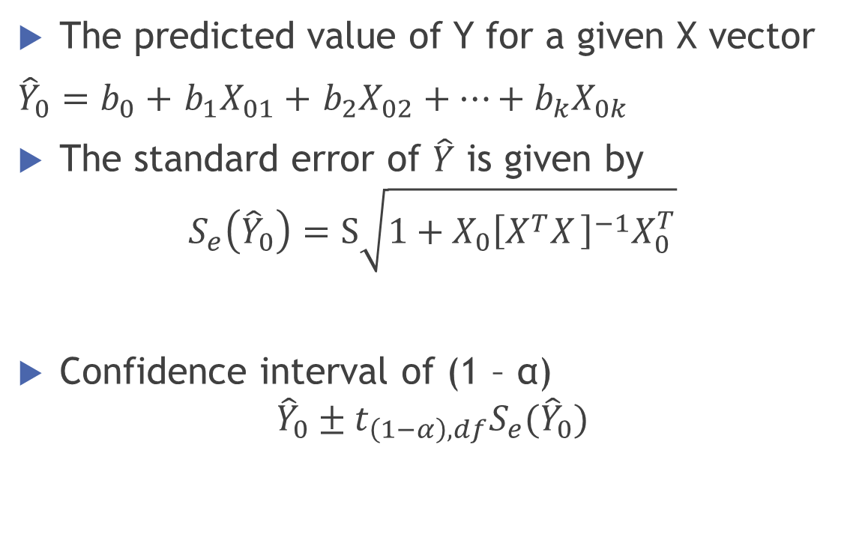
Prediction and Prediction Intervals
The predicted value of Y for a given X vector
${\hat{Y}}_{0}=b_{0}+$ $b_{1}X_{01}+$ $b_{2}X_{02}+…+b_{k}X_{0k}$
The standard error of $\hat{Y}$ is given by
$$S_{e}\left({\hat{Y}}_{0}\right)=S\sqrt{1+X_{0}{\left[X_{ }^{T}X_{ }\right]}^{−1}X_{0}^{T}}$$
Confidence interval of (1 – α)
$${\hat{Y}}_{0}±t_{\left(1−α\right),df}S_{e}({\hat{Y}}_{0})$$

Slide 25
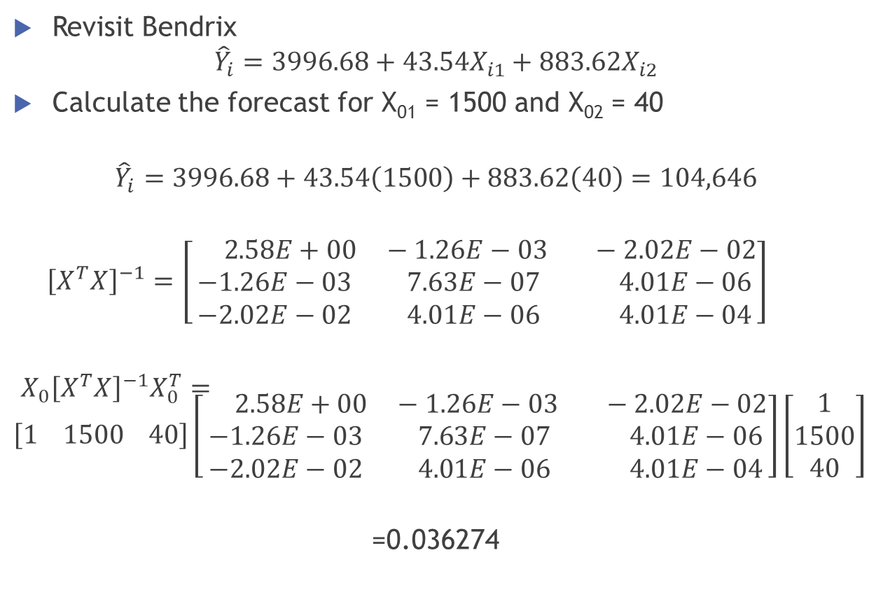
Prediction Interval - Example
Revisit Bendrix
$${\hat{Y}}_{i}=3996.68+43.54X_{i1}+883.62X_{i2}$$
Calculate the forecast for X₀₁ = 1500 and X₀₂ = 40
$${\hat{Y}}_{i}=3996.68+43.54\left(1500\right)+883.62\left(40\right)=104,646$$
${\left[X^{T}X\right]}^{−1}=\left[\begin{aligned} 2.58E+00 −1.26E−03 −2.02E−02 \\ −1.26E−03 7.63E−07 4.01E−06 \\ −2.02E−02 4.01E−06 4.01E−04\end{aligned}\right]$
${X_{0}\left[X^{T}X\right]}^{−1}X_{0}^{T}=\left[1 1500 40\right]\left[\begin{aligned} 2.58E+00 −1.26E−03 −2.02E−02 \\ −1.26E−03 7.63E−07 4.01E−06 \\ −2.02E−02 4.01E−06 4.01E−04\end{aligned}\right]\left[\begin{aligned}1 \\ 1500 \\ 40\end{aligned}\right]$
=0.036274

Slide 26
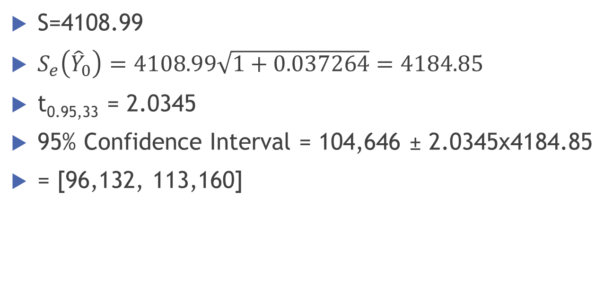
Bendrix
S=4108.99
$S_{e}\left({\hat{Y}}_{0}\right)=4108.99\sqrt{1+0.037264}=4184.85$
t_{0.95,33} = 2.0345
95% Confidence Interval = 104,646 ± 2.0345x4184.85
= [96,132, 113,160]

Slide 27
Methods of Variable Selection
Forward
Assume that we have k independent variables
Calculate the correlations between dependent variable and all independent variables
Develop a simple linear regression model with the independent variable having highest correlation with the dependent variable (The p-value must me less than pre-defined α)
Add variable X_{j} with smallest p-value based on “Partial F value”. (The p-value must me less than pre-defined α)
Repeat above step till (a) all independent variables are exhausted or (b) p-value based on partial F test is more than α

Slide 28
Forward Selection
Variables Entered/Removedª
Model | Variables Entered | Variables Removed | Method
1 | T2 |  | Forward (Criterion: Probability-of-F-to-enter <= .050)
2 | OTINC |  | Forward (Criterion: Probability-of-F-to-enter <= .050)
3 | MATERIAL |  | Forward (Criterion: Probability-of-F-to-enter <= .050)
4 | SALES |  | Forward (Criterion: Probability-of-F-to-enter <= .050)
a. Dependent Variable: PBT
Model Summary
Model | R | R Square | Adjusted R Square | Std. Error of the Estimate
1 | .955ª | .911 | .906 | 526.5058
2 | .975^{b} | .951 | .945 | 404.3057
3 | .981^{c} | .963 | .956 | 361.1521
4 | .987^{d} | .975 | .968 | 305.8223
a. Predictors: (Constant), T2
b. Predictors: (Constant), T2, OTINC
c. Predictors: (Constant), T2, OTINC, MATERIAL
d. Predictors: (Constant), T2, OTINC, MATERIAL, SALES

Slide 29
Forward Selection
Coefficients
Model |  | Unstandardized Coefficients |  | Standardized Coefficients | t | Sig.
 |  | B | Std. Error | Beta
1 | (Constant) | 392.134 | 179.515 |  | 2.184 | .042
 | T2 | 12.835 | .944 | .955 | 13.590 | .000
2 | (Constant) | 497.386 | 140.790 |  | 3.533 | .003
 | T2 | 9.229 | 1.219 | .686 | 7.568 | .000
 | OTINC | .482 | .131 | .334 | 3.678 | .002
3 | (Constant) | 439.183 | 128.276 |  | 3.424 | .003
 | T2 | 13.046 | 1.983 | .970 | 6.579 | .000
 | OTINC | .553 | .121 | .383 | 4.569 | .000
 | MATERIAL | -.048 | .021 | -.343 | -2.303 | .035
4 | (Constant) | 330.452 | 115.826 |  | 2.853 | .012
 | T2 | 7.811 | 2.563 | .581 | 3.048 | .008
 | OTINC | .080 | .203 | .055 | .392 | .700
 | MATERIAL | -.240 | .073 | -1.701 | -3.286 | .005
 | SALES | .148 | .055 | 2.009 | 2.704 | .016

Slide 30
Methods of Variable Selection
Backward
Assume that we have k independent variables
Develop a multiple linear regression model with all the k independent variables (Model 1)
Remove one variable at a time repeatedly from the above model and calculate p-value corresponding to partial F test for each of the k reduced models (Models 2)
From Model 1, remove the variable with highest p-value (The p-value must be more than pre-defined α)
Repeat above steps till (a) p-value becomes less than α or(b) there are no independent variables left in the model

Slide 31
Backward Selection
Coefficientsª
Model |  | Unstandardized Coefficients |  | Standardized Coefficients | t | Sig.
 |  | B | Std. Error | Beta
1 | (Constant) | 4575.011 | 3878.233 |  | 1.180 | .261
 | SALES | .133 | .062 | 1.804 | 2.160 | .052
 | MATERIAL | -.223 | .079 | -1.581 | -2.838 | .015
 | OTINC | .077 | .221 | .053 | .350 | .733
 | EMPL | -.307 | .293 | -.316 | -1.047 | .316
 | INT | -.006 | .335 | -.005 | -.018 | .986
 | T | 138.031 | 208.641 | .475 | .662 | .521
 | T2 | 6.526 | 9.890 | .485 | .660 | .522
2 | (Constant) | 4574.598 | 3726.074 |  | 1.228 | .241
 | SALES | .133 | .059 | 1.804 | 2.249 | .043
 | MATERIAL | -.223 | .075 | -1.582 | -2.960 | .011
 | OTINC | .076 | .206 | .053 | .370 | .717
 | EMPL | -.307 | .281 | -.316 | -1.091 | .295
 | T | 139.098 | 192.446 | .479 | .723 | .483
 | T2 | 6.439 | 8.333 | .479 | .773 | .454
3 | (Constant) | 4598.645 | 3608.891 |  | 1.274 | .223
 | SALES | .151 | .033 | 2.047 | 4.586 | .000
 | MATERIAL | -.245 | .045 | -1.738 | -5.485 | .000
 | EMPL | -.310 | .272 | -.320 | -1.139 | .274
 | T | 142.007 | 186.266 | .489 | .762 | .458
 | T2 | 5.756 | 7.872 | .428 | .731 | .477
4 | (Constant) | 5993.152 | 3015.834 |  | 1.987 | .065
 | SALES | .163 | .028 | 2.206 | 5.752 | .000
 | MATERIAL | -.247 | .044 | -1.751 | -5.622 | .000
 | EMPL | -.428 | .216 | -.441 | -1.979 | .066
 | T | 258.949 | 93.977 | .891 | 2.755 | .015

Slide 32
Stepwise Selection
A combination of both Forward and Backward Selection
Pre-decide the criteria for a new variable to enter the model when the p-value is less than the pre-decided value (p-in) and also the criteria for removal of a variable from the model when the p-value is more than the pre-decided value (p-out)
The p-values for entering or removing are based on partial F tests
It is imperative that p-in < p-out
The very first variable to be entered into then model is the one which has the highest correlation with the dependent variable (assuming that the corresponding p-value is less than p-in
At each subsequent step, a variable is either entered into the model (if the p-value is less than p-in) or a variable is removed from the model (if p-value is more than p-out)
The process continues until (a) there are no more variables left, or (b) no more variable to be entered based on p-in criterion or ( c) there are no variables in the equation for removal based on the p-out criterion

Slide 33
Stepwise Selection
Variables Entered/Removedª
Model | Variables Entered | Variables Removed | Method
1 | T2 |  | Stepwise (Criteria: Probability-of-F-to-enter <= .050, Probability-of-F-to-remove >= .100).
2 | OTINC |  | Stepwise (Criteria: Probability-of-F-to-enter <= .050, Probability-of-F-to-remove >= .100).
3 | MATERIAL |  | Stepwise (Criteria: Probability-of-F-to-enter <= .050, Probability-of-F-to-remove >= .100).
4 | SALES |  | Stepwise (Criteria: Probability-of-F-to-enter <= .050, Probability-of-F-to-remove >= .100).
5 |  | OTINC | Stepwise (Criteria: Probability-of-F-to-enter <= .050, Probability-of-F-to-remove >= .100).
a. Dependent Variable: PBT

Slide 34
Stepwise Selection
Model Summary
Model | R | R Square | Adjusted R Square | Std. Error of the Estimate
1 | .955ª | .911 | .906 | 526.5058
2 | .975^{b} | .951 | .945 | 404.3057
3 | .981^{c} | .963 | .956 | 361.1521
4 | .987^{d} | .975 | .968 | 305.8223
5 | .987e | .975 | .970 | 297.6273
a. Predictors: (Constant), T2
b. Predictors: (Constant), T2, OTINC
c. Predictors: (Constant), T2, OTINC, MATERIAL
d. Predictors: (Constant), T2, OTINC, MATERIAL, SALES
e. Predictors: (Constant), T2, MATERIAL, SALES

Slide 35
Stepwise Selection
ANOVAª
Model |  | Sum of Squares | df | Mean Square | F | Sig.
1 | Regression | 51,200,644 | 1 | 51,200,644 | 184.701 | .000^{b}
 | Residual | 4,989,750 | 18 | 277,208
 | Total | 56,190,394 | 19
2 | Regression | 53,411,521 | 2 | 26,705,761 | 163.375 | .000^{c}
 | Residual | 2,778,873 | 17 | 163,463
 | Total | 56,190,394 | 19
3 | Regression | 54,103,500 | 3 | 18,034,500 | 138.269 | .000^{d}
 | Residual | 2,086,894 | 16 | 130,431
 | Total | 56,190,394 | 19
4 | Regression | 54,787,484 | 4 | 13,696,871 | 146.448 | .000e
 | Residual | 1,402,910 | 15 | 93,527
 | Total | 56,190,394 | 19
5 | Regression | 54,773,082 | 3 | 18,257,694 | 206.111 | .000^{f}
 | Residual | 1,417,312 | 16 | 88,582
 | Total | 56,190,394 | 19
a. Dependent Variable: PBT
b. Predictors: (Constant), T2
c. Predictors: (Constant), T2, OTINC
d. Predictors: (Constant), T2, OTINC, MATERIAL
e. Predictors: (Constant), T2, OTINC, MATERIAL, SALES
f. Predictors: (Constant), T2, MATERIAL, SALES

Slide 36
Stepwise Selection
Coefficientsª
Model |  | Unstandardized Coefficients |  | Standardized Coefficients | t | Sig.
 |  | B | Std. Error | Beta
1 | (Constant) | 392.134 | 179.515 |  | 2.184 | .042
 | T2 | 12.835 | .944 | .955 | 13.590 | .000
2 | (Constant) | 497.386 | 140.790 |  | 3.533 | .003
 | T2 | 9.229 | 1.219 | .686 | 7.568 | .000
 | OTINC | .482 | .131 | .334 | 3.678 | .002
3 | (Constant) | 439.183 | 128.276 |  | 3.424 | .003
 | T2 | 13.046 | 1.983 | .970 | 6.579 | .000
 | OTINC | .553 | .121 | .383 | 4.569 | .000
 | MATERIAL | -.048 | .021 | -.343 | -2.303 | .035
4 | (Constant) | 330.452 | 115.826 |  | 2.853 | .012
 | T2 | 7.811 | 2.563 | .581 | 3.048 | .008
 | OTINC | .080 | .203 | .055 | .392 | .700
 | MATERIAL | -.240 | .073 | -1.701 | -3.286 | .005
 | SALES | .148 | .055 | 2.009 | 2.704 | .016
5 | (Constant) | 313.769 | 104.856 |  | 2.992 | .009
 | T2 | 7.226 | 2.030 | .537 | 3.560 | .003
 | MATERIAL | -.263 | .042 | -1.865 | -6.245 | .000
 | SALES | .167 | .027 | 2.261 | 6.188 | .000
a. Dependent Variable: PBT

Slide 37
Stepwise Selection
Excluded Variablesª
Model |  | Beta In | t | Sig. | Partial Correlation | Collinearity Statistics
 |  |  |  |  |  | Tolerance
1 | SALES | .167^{b} | .640 | .530 | .153 | .075
 | MATERIAL | -.169^{b} | -.798 | .436 | -.190 | .112
 | OTINC | .334^{b} | 3.678 | .002 | .666 | .354
 | EMPL | -.223^{b} | -1.626 | .122 | -.367 | .240
 | INT | .282^{b} | 1.292 | .214 | .299 | .100
 | T | -.338^{b} | -1.153 | .265 | -.269 | .056
2 | SALES | -.358^{c} | -1.559 | .139 | -.363 | .051
 | MATERIAL | -.343^{c} | -2.303 | .035 | -.499 | .105
 | EMPL | -.017^{c} | -.130 | .899 | -.032 | .175
 | INT | -.148^{c} | -.682 | .505 | -.168 | .064
 | T | .115^{c} | .427 | .675 | .106 | .042
3 | SALES | 2.009^{d} | 2.704 | .016 | .572 | .003
 | EMPL | -.214^{d} | -1.673 | .115 | -.397 | .127
 | INT | .153^{d} | .648 | .527 | .165 | .043
 | T | -.395^{d} | -1.318 | .207 | -.322 | .025
4 | EMPL | -.127e | -1.050 | .312 | -.270 | .114
 | INT | .055e | .269 | .792 | .072 | .042
 | T | -.176e | -.624 | .542 | -.165 | .022
5 | OTINC | .055^{f} | .392 | .700 | .101 | .084
 | EMPL | -.126^{f} | -1.075 | .299 | -.267 | .114
 | INT | .068^{f} | .348 | .733 | .089 | .043
 | T | -.173^{f} | -.631 | .538 | -.161 | .022

Slide 38
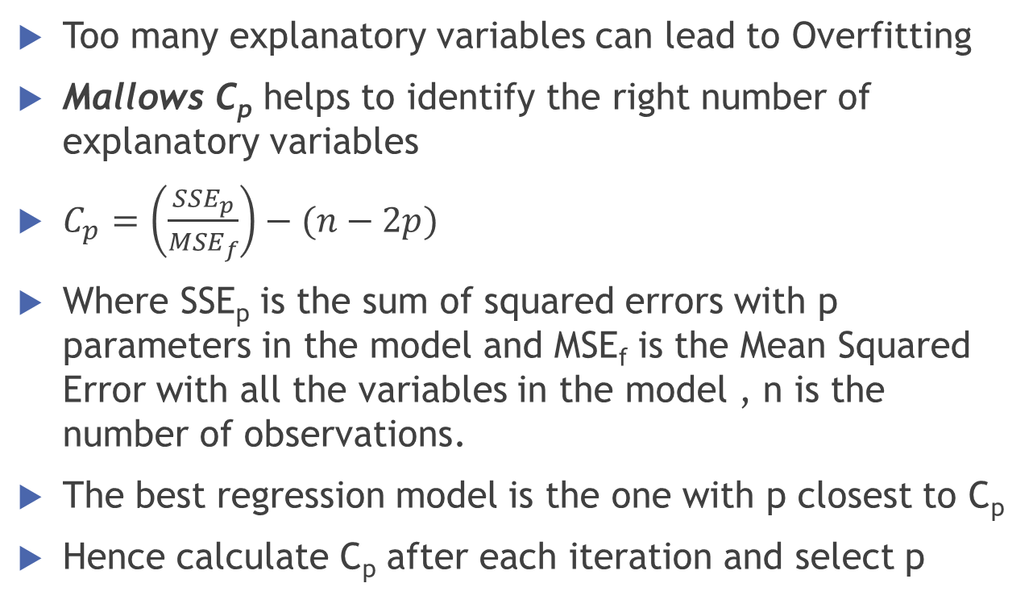
Overfitting
Too many explanatory variables can lead to Overfitting
Mallows C_{p} helps to identify the right number of explanatory variables
$C_{p}=\left(\frac{{SSE}_{p}}{{MSE}_{f}}\right)−(n−2p)$
Where SSE_{p} is the sum of squared errors with p parameters in the model and MSE_{f} is the Mean Squared Error with all the variables in the model , n is the number of observations.
The best regression model is the one with p closest to C_{p}
Hence calculate C_{p} after each iteration and select p

Slide 39
Multicollinearity
High correlation between X variables
Coefficients measure combined effect
Leads to unstable coefficients depending on X variables in model
Always exists; matter of degree
Notes:
When we try to develop a regression model, we want,
Model as a whole must be significant.
2. Each independent variable must explain variation in Y in a significant manner given the presence of the rest of the variables.
3. For this each independent variable must have high correlation with Y, and at the same time it is desirable for them to have as little correlation amongst them as possible. If not, we have multicollinearity.

Slide 40
Multicollinearity in practice
In practice, perfect multicollinearity (e.g. X₃ = 2X₁ – 3X₂) is rare, unless some error has been committed
But high correlation between predictor variables could be problematic (approx. benchmark |r| > 0.7)
Variance Inflation Factors (VIF) are typically used to confirm this suspicion
  Regress each predictor variable (X_{j}) on the remaining predictors and calculate R_{j}²
  VIF_{j} = 1/(1-R_{j}²) is the variance inflation factor associated with predictor variable j
  High VIF => large variation in this predictor variable is explained by other predictor variables
  Rule of thumb is VIF>10

Slide 41
Other indicators/signs of multicollinearity
Large F-value (overall significance) and/or R², but low t-values (individual significance)
  The loss of precision in “partialling” out the effects of individual predictors does not affect overall significance
The parameter estimates maybe unstable – jump around for small changes in data
Unexpected signs for the coefficients
Suspect multicollinearity if your approach is “kitchen sink” regression

Slide 42
Agricultural Production Data
Production | Seed | Labor | Ln (Prod) | Ln(Seed) | Ln(Lab)
70 | 80 | 810 | 4.25 | 4.38 | 6.7
65 | 100 | 1009 | 4.17 | 4.61 | 6.92
90 | 120 | 1273 | 4.5 | 4.79 | 7.15
95 | 140 | 1425 | 4.55 | 4.94 | 7.26
110 | 160 | 1633 | 4.7 | 5.08 | 7.4
115 | 180 | 1876 | 4.74 | 5.19 | 7.54
120 | 200 | 2052 | 4.79 | 5.3 | 7.63
140 | 220 | 2201 | 4.94 | 5.39 | 7.7
155 | 240 | 2435 | 5.04 | 5.48 | 7.8
150 | 260 | 2686 | 5.01 | 5.56 | 7.9

Slide 43
Production Data
R | R Square | Adjusted R Square | Std. Error of the Estimate
.982ª | .964 | .953 | 6.8080
 | Sum of Squares | df | Mean Square | F | Sig.
Regression | 8565.554 | 2 | 4282.777 | 92.402 | .000
Residual | 324.446 | 7 | 46.349
Total | 8890.000 | 9
 | Unstandardized Coefficients |  | Standardized Coefficients | t | Sig.
 | B | Std. Error | Beta
(Constant) | 24.775 | 6.752 |  | 3.669 | .008
Seed | .942 | .823 | 1.814 | 1.144 | .290
Labour | -.042 | .081 | -.834 | -.526 | .615

Slide 44
Correlation Matrix
 |  | Production | Seed | Labour
Production | Pearson Correlation | 1 | .981** | .978**
 | Sig. (2-tailed) |  | .000 | .000
 | N | 10 | 10 | 10
Seed | Pearson Correlation | .981** | 1 | .999**
 | Sig. (2-tailed) | .000 |  | .000
 | N | 10 | 10 | 10
Labour | Pearson Correlation | .978** | .999** | 1
 | Sig. (2-tailed) | .000 | .000
 | N | 10 | 10 | 10

Slide 45
Collinearity Statistics
 | Unstandardized Coefficients |  | t | Sig. | Correlations |  |  | Collinearity Statistics
 | B | Std. Error |  |  | Zero-order | Partial | Part | Tolerance | VIF
(Constant) | 24.775 | 6.752 | 3.669 | .008
Seed | .942 | .823 | 1.144 | .290 | .981 | .397 | .083 | .002 | 482.128
Labour | -.042 | .081 | -.526 | .615 | .978 | -.195 | -.038 | .002 | 482.128
Tolerance, is 1 minus that R² (between the two predictors)
VIF, the variance inflation factor is the reciprocal of the tolerance. Very low values of tolerance (.1 or less) indicate a problem. Very high values of VIF (10 or more, although some would say 5 or even 4) indicate a problem.
Semipartial correlation coefficients, are called“ part correlations“ by SPSS

Slide 46
Revisit United Technologies
Coefficientsª
 | Unstandardized Coefficients |  | t | Sig. | Correlations |  |  | Collinearity Statistics
 | B | Std. Error |  |  | Zero-order | Partial | Part | Tolerance | VIF
(Constant) | 251.765 | 942.077 | .267 | .792
MATERIAL | 1.434 | .151 | 9.514 | .000 | .990 | .918 | .251 | .112 | 8.944
T2 | 46.519 | 14.374 | 3.236 | .005 | .962 | .617 | .085 | .112 | 8.944
a. Dependent Variable: SALES
After Log Transformation
Coefficientsª
 | Unstandardized Coefficients |  | t | Sig. | Correlations |  |  | Collinearity Statistics
 | B | Std. Error |  |  | Zero-order | Partial | Part | Tolerance | VIF
(Constant) | 1.710 | .321 | 5.319 | .000
LnMat | .862 | .048 | 18.144 | .000 | .992 | .975 | .488 | .294 | 3.401
LnT2 | .066 | .030 | 2.194 | .042 | .866 | .470 | .059 | .294 | 3.401
a. Dependent Variable: LnSales

Slide 47

Log Transformations
Coefficientsª
 | Unstandardized Coefficients |  | Standardized Coefficients | t | Sig.
 | B | Std. Error | Beta
(Constant) | -1.862 | .538 |  | -3.458 | .003
LnSales | 2.356 | .333 | 2.827 | 7.078 | .000
LnMat | -1.510 | .319 | -1.893 | -4.739 | .000
a. Dependent Variable: LnPBT
Covariances
 | LnSales | LnMat
LnSales | .169 | -.139
LnMat | -.139 | .117
$$H_{0}: β_{1}+β_{2}=1 (Constant Returns to scale)$$
$$H_{A}: β_{1}+β_{2}≠1 (Constant Returns to scale)$$
$$S_{e(b_{1}+b_{2)}=\sqrt{V\left(b_{1}\right)+V\left(b_{2}\right)+2Cov(b_{1}b_{2})}}=\sqrt{0.169+0.117−2\left(0.139\right)=}0.0868$$
$t=\frac{b_{1}+b_{2}−1}{S_{e(b_{1}+b_{2})}}=\frac{(2.356−1.510−1)}{0.0868}=−1.7816$
p-value = 0.118

Slide 48
Correcting for Multicollinearity
Do nothing
  If the sole purpose of the model is prediction (since estimates of y are unbiased)
  If deleting a variable greatly reduces R².
Drop the variable
  However, beware that this might introduce an omitted variable bias
  Rule of thumb is to drop variables with high VIF but use managerial intuition and knowledge
Use a priori information
  Build a new compound variable that is a function of the correlated variables

Slide 49
Heteroscedasticity
If the width of the scatter plot of the residuals either increase or decrease then the variance of the error term is not constant. This problem is called Heteroscedasticity.
When heteroscedasticity exist, we cannot use the ordinary least-squares method for estimating the regression and should use a more complex method called generalized least squares.

Slide 50
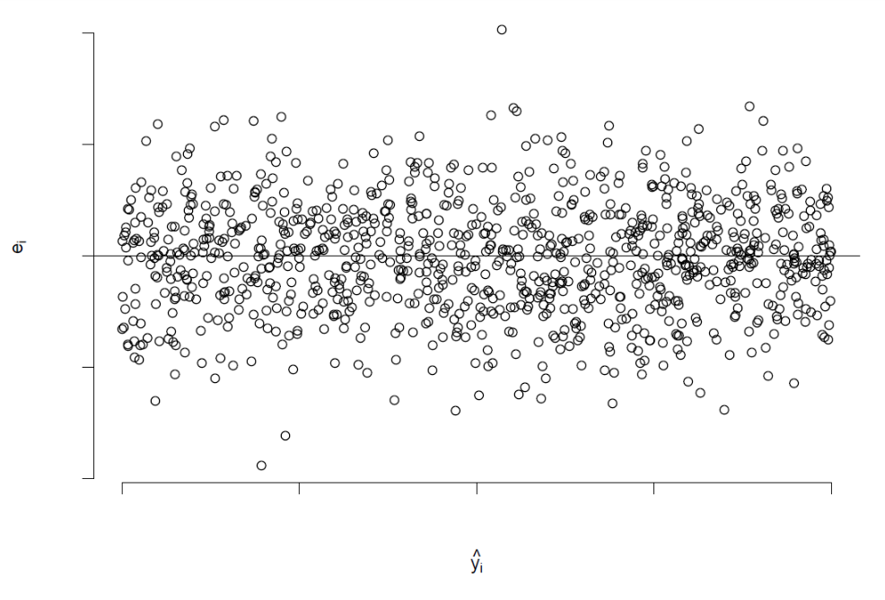
No Pattern is Good Pattern

Slide 51
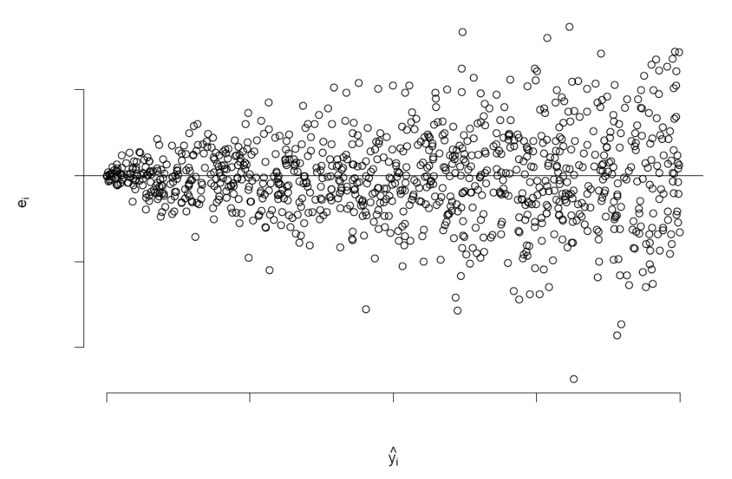
Heteroscedasticity

Slide 52
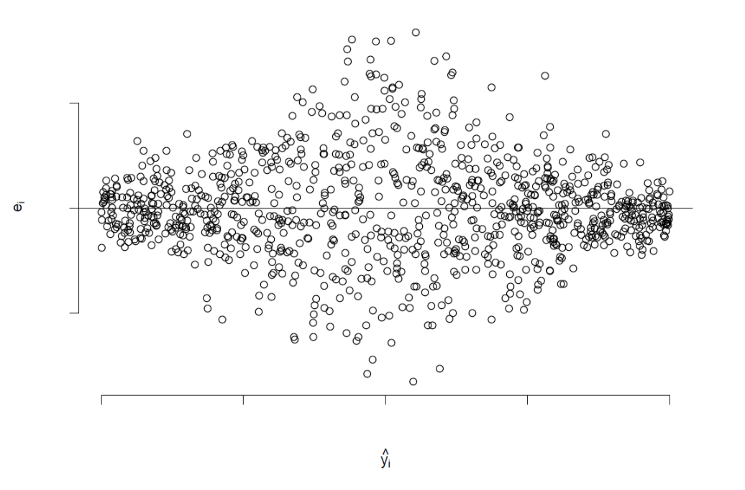
Heteroscedasticity

Slide 53
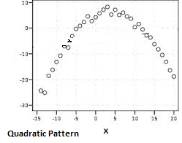
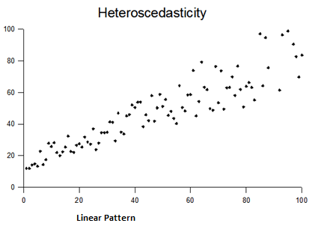
Heteroskedasticity

Slide 54
Park’s Test
Simple test is Park Test
  Fit a regression equation
  Ln e_{i}² = a + b_{i} ln X_{i}
  If b is statistically significant, then there is a presence of Heteroscedasticity
Other Tests
  Breusch-Pagan (BP) Test
  White’s Test of Heteroscedasticity
  Other tests such as Glejser, Spearman’s rank correlation, and Goldfeld-Quandt tests of heteroscedasticity

Slide 55
Park’s Test – UTI
 | Unstandardized Coefficients |  | Standardized Coefficients | t | Sig.
 | B | Std. Error | Beta
(Constant) | 733.934 | 495.701 |  | 1.481 | .158
MATERIAL | 1.292 | .081 | .676 | 15.917 | .000
T2 | 35.339 | 7.663 | .194 | 4.611 | .000
OTINC | 3.195 | .468 | .163 | 6.832 | .000
ANOVAª
 | Sum of Squares | df | Mean Square | F | Sig.
Regression | 13.100 | 3 | 4.367 | .757 | .534^{b}
Residual | 92.247 | 16 | 5.765
Total | 105.346 | 19
Dependent: Ln_Res_Sqrd; Predictors:Constant, L_T2, L_MATERIAL, L_OTINC
 | Unstandardized Coefficients |  | Standardized Coefficients | t | Sig.
 | B | Std. Error | Beta
(Constant) | 16.795 | 6.730 |  | 2.496 | .024
L_MATERIAL | .216 | 1.136 | .094 | .190 | .851
L_OTINC | -1.553 | 1.127 | -.788 | -1.378 | .187
L_T2 | .801 | .766 | .553 | 1.046 | .311

Slide 56
Normality Asssumption

Slide 57
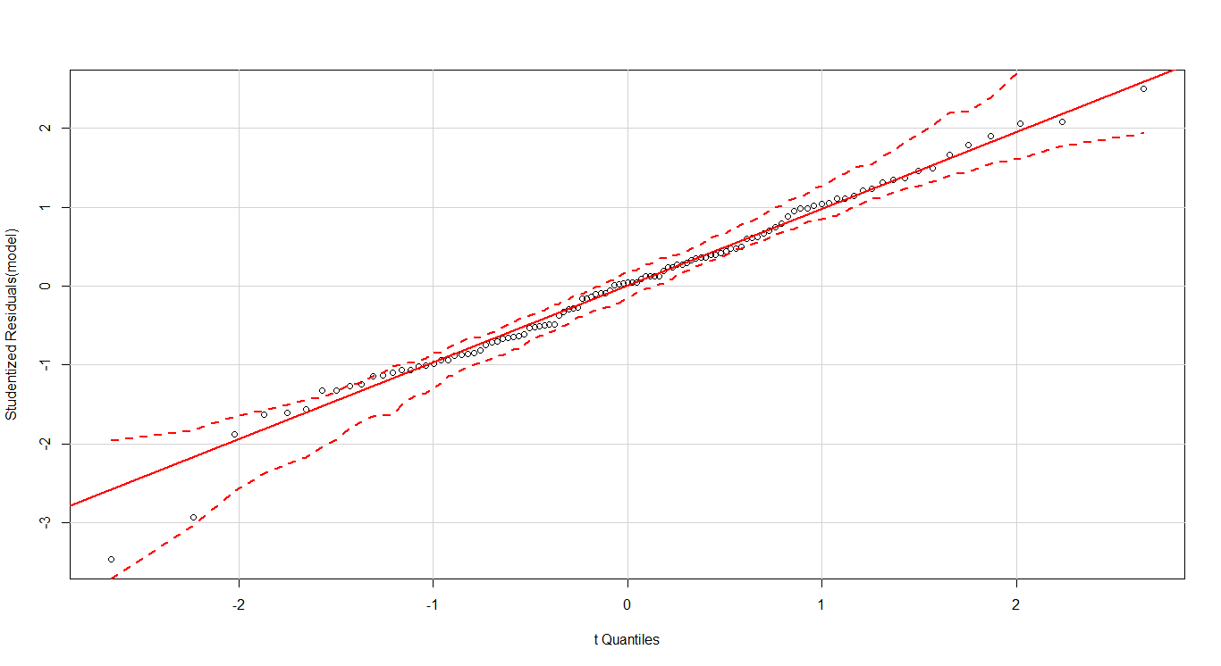
QQ-Plot

Slide 58
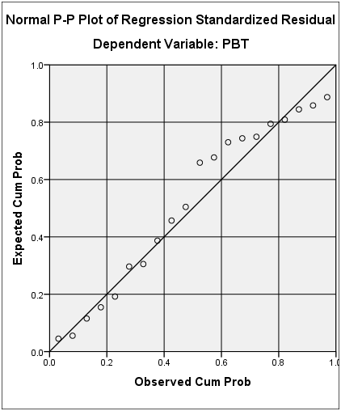
United Technologies-Normal Distribution

Slide 59
Goodness of Fit – KS Test
One-Sample Kolmogorov-Smirnov Test
 |  | Unstandardized Residuals
N |  | 20
Normal Parameters^{a,b} | Mean | 0.0000
 | Std. Deviation | 256.5246
Most Extreme Differences | Absolute | .119
 | Positive | .081
 | Negative | -.119
Test Statistic |  | .119
Asymp. Sig. (2-tailed) |  | .200^{c,d}
a. Test distribution is Normal.
b. Calculated from data.
c. Lilliefors Significance Correction.
d. This is a lower bound of the true significance.

Slide 60
Questions?

